Slide 1
Classification and Text Analysis of Public Comments to Regulations
Arthur Pignotti
Health Insurance Specialist
CMS
Medicare Plan Payment Group
arthur.pignotti@cms.hhs.gov
INFORMATION NOT RELEASABLE TO THE PUBLIC UNLESS AUTHORIZED BY LAW:
This information has not been publicly disclosed and may be privileged and confidential. It is for internal government use only and must not be disseminated, distributed, or copied to persons not authorized to receive the information. Unauthorized disclosure may result in prosecution to the full extent of the law.
Notes:
RECONCILIATION CALCULATIONS use PDE data with a processed date on or before 6/30/2016 cycle 3 (“20160630 Cycle 3”)
DIR data with a processed date on or before 8/31/2016

Slide 2
What Problem Am I Trying to Solve: Classification of Comments for SMEs and Analysis
Problem
+1,000 pages of comments in mostly PDF form that need to be sorted and read by SMEs
Current Solution
A handful of unlucky people work over the weekend to convert, read and sort the documents
New Solution
Use programming to convert documents and topic modeling to sort them and do analysis

Slide 3
Approach to Classification
Method Choice: Topic Modeling (topicmodels package)
Since comments can refer to multiple parts of the regulation, topic modeling, using Latent Dirichlet Allocation (LDA), is a better approach to other standard classification approaches
Since topic modeling is more for clustering instead of classification, must combine model outputs to bridge the comments to the regulation sections via the model topics
What is LDA?
It’s a generative probabilistic model that attempts to create latent topic clusters that has certain probabilities for terms to topics and baseline documents to topics

Slide 4
Classification/Topic Modeling Workflow
Apply Topic Model to Comments
Build Topic Model
Clean Data, Removing Stop Words
Clean Data, Removing Stop Words and Normalizing Commonly Misspelled Words
Convert PDFs and Extract Text using VBA/Adobe
Integrate Common Bigrams
Edit Topic Term Weights with SME Input
Download Comments for Regulations.gov
Integrate Common Bigrams from Model Building Flow
Remove Comments with Abnormal Amount of Misspelling and Duplicate Comments
Normalize Scores
Bridge Topic Scores to Regulation Sections
Break Up Document into Sections
Build Topic Model from Regulation Document
Prepare Comments for the Model

Slide 5
Fun Decisions to Enhance Process
Spell Checking to Find Problems
Calculate ratios of misspelled to total words to identify either junk comments or documents that OCR problems
Integrate bigram (2-word phrases) into models
There are a number of significant topic-specific phrases that improve model classification
Identify Write-In Campaigns and Duplicate Documents
Use cosine similarity on all documents
Allow SMEs to Enhance Model with Their Expertise
The model outputs probabilities of terms in topic (beta), which can be edited

Slide 6
Bridge Between Comments and Regulation Sections
Topics
Regulation
Section
.9
.85
Comment
.8
.01
.01
.1
.05
Using term weights (beta),
assigns topic scores (gamma)
Multiply topic scores (gamma) by
regulation section’s topic score
from building the model

Slide 7
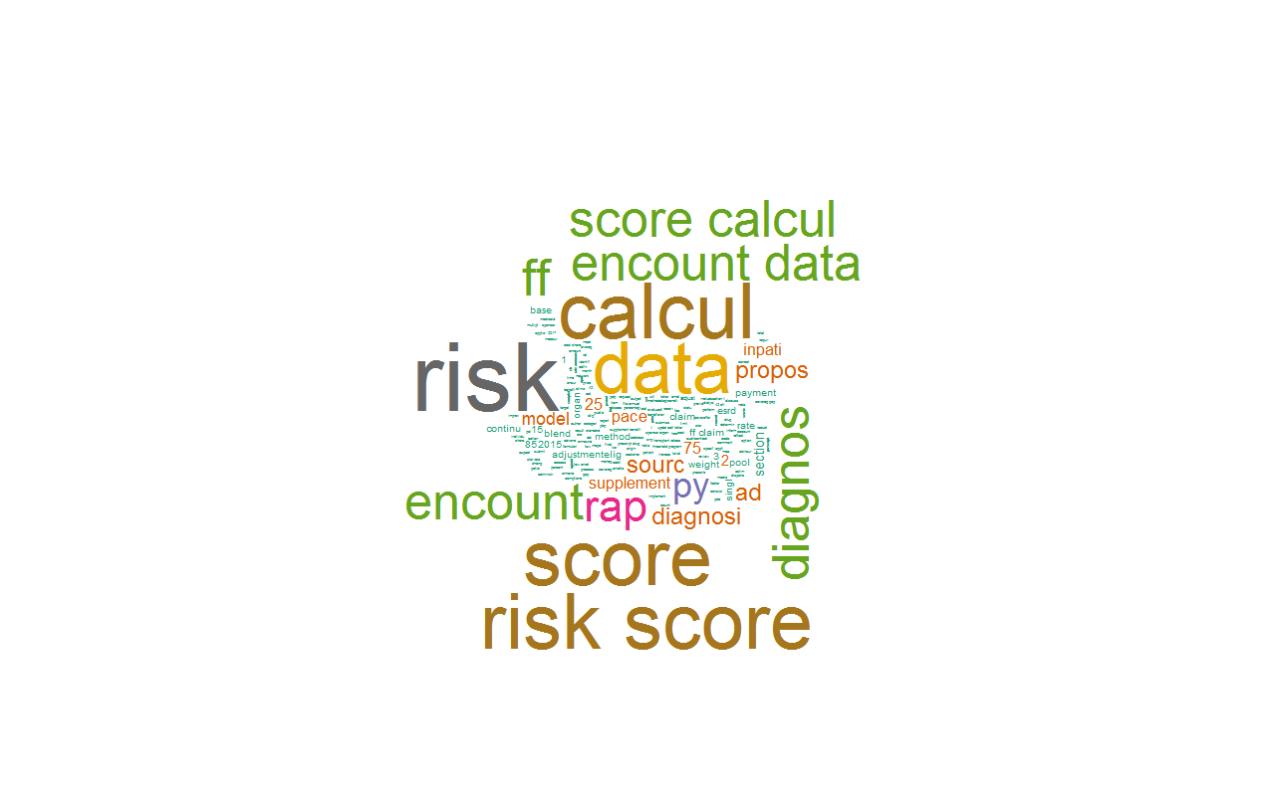
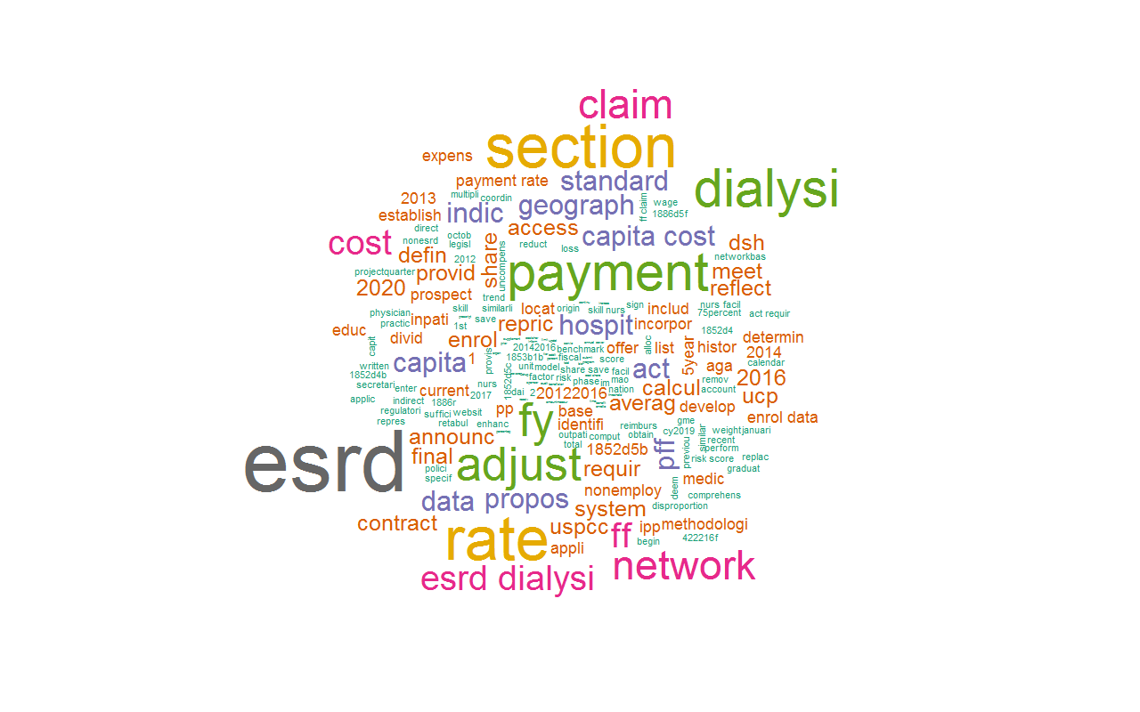
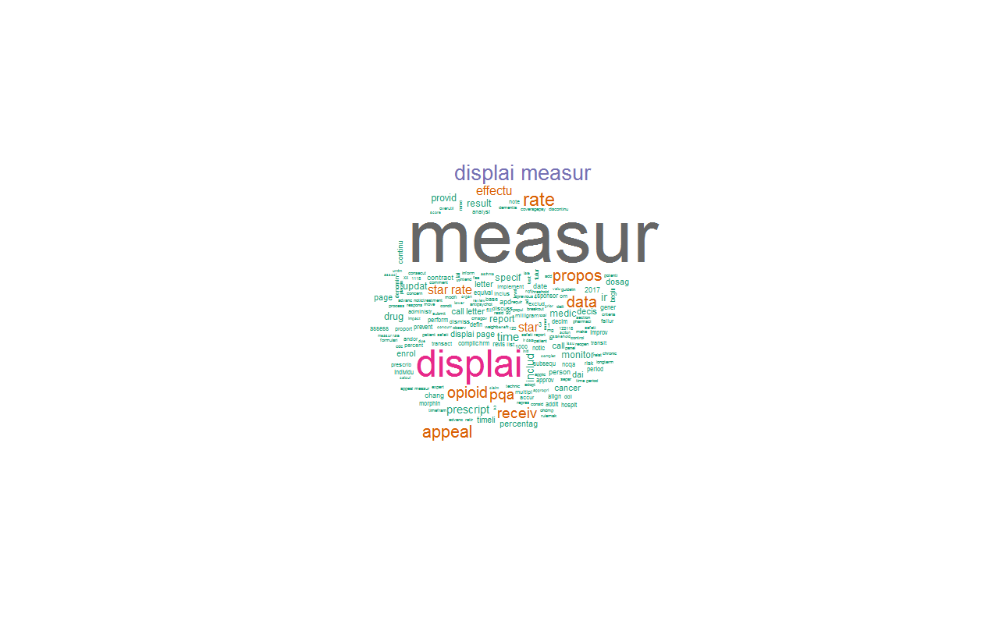
Quick Peek at the Model
Encounter Data as
a Diagnosis Source
Star Ratings:
Display Measures
ESRD Rates

Slide 8
Things to Do
Continue data cleaning
Systematize model editing of terms
Try other topic models
Figure out good ways to tune model hyperparameters
Find ways to use accurately classified comments to enhance model
Since currently the model only uses the baseline document (reg), if any important terms or synonyms are not in the document, they not in the model

